Slide 1
Term Project Presentation
By: team 14d
Hussein Okasha, Nick Lewis

Slide 2
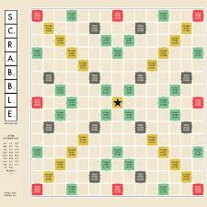
Goal and Motivation
Goal: Design and build an algorithm to maximize the efficiency of a game of Scrabble
Motivation: Make this program the best possible

Slide 3
Initial Approach/ Submission

Slide 4
Ideas Devised Within the Group
Steps
Make a standard trie using hashmaps, which makes traversing and inserting easier
Insert the legalwords.txt and store it into the dictionary, decreases the memory
Store all values as Bytes, and store hashmap letters as Boolean *PLEASE DOUBLE CHECK*

Slide 5
*INSERT PICTURE OF GRAPH HERE*

Slide 6

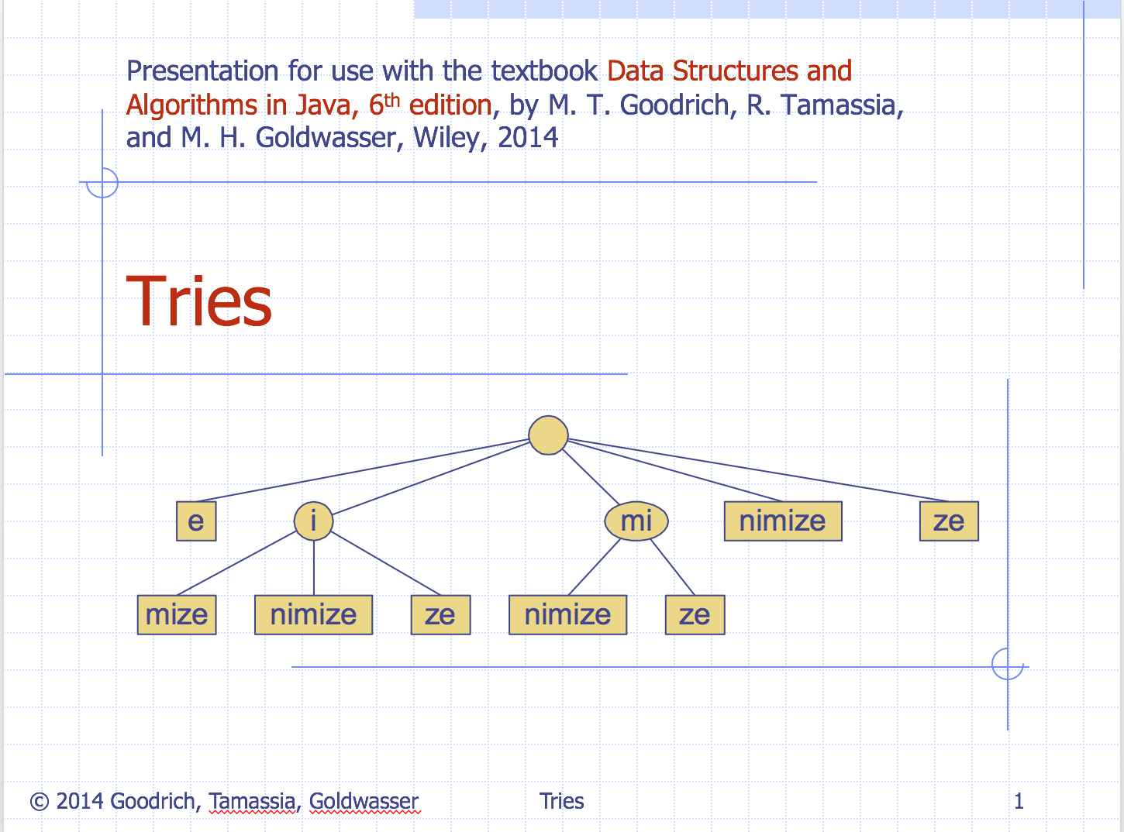
Ideas Discussed in the Course/Book
Storing the Dictionary
Standard Trie
Compressed Trie
Hash Maps
Traversal Methods
Breadth First Search (BFS)
Depth First Search (DFS)

Slide 7

Ideas Borrowed From Other Sources
We searched through the internet for ideas of the best data structure to use to store the dictionary
However, no sources were satisfactory for solving this problem so we made our own trie and traversal

Slide 8
Algorithms and Supporting Data Structures
Storing the Dictionary
Standard trie tree with Hashmaps to link all 26 letters of the alphabet
Traversing the ScrabbleBoard Quadrents
Traversal similar to Breadth First Search (BFS)*PLEASE CHECK*
Additional Input & Data
No additional input

Slide 9
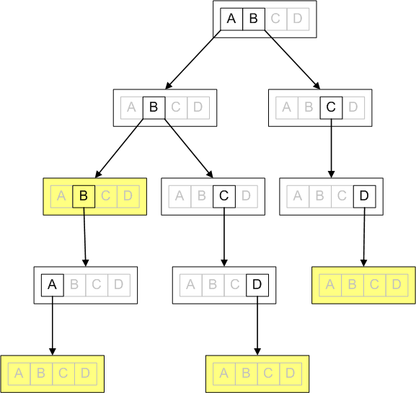
Representation of a Standard Trie Using a Hashmap

Slide 10
*SCREENSHOT SNIPPET OF TRIE CODE TO EXPLAIN*

Slide 11
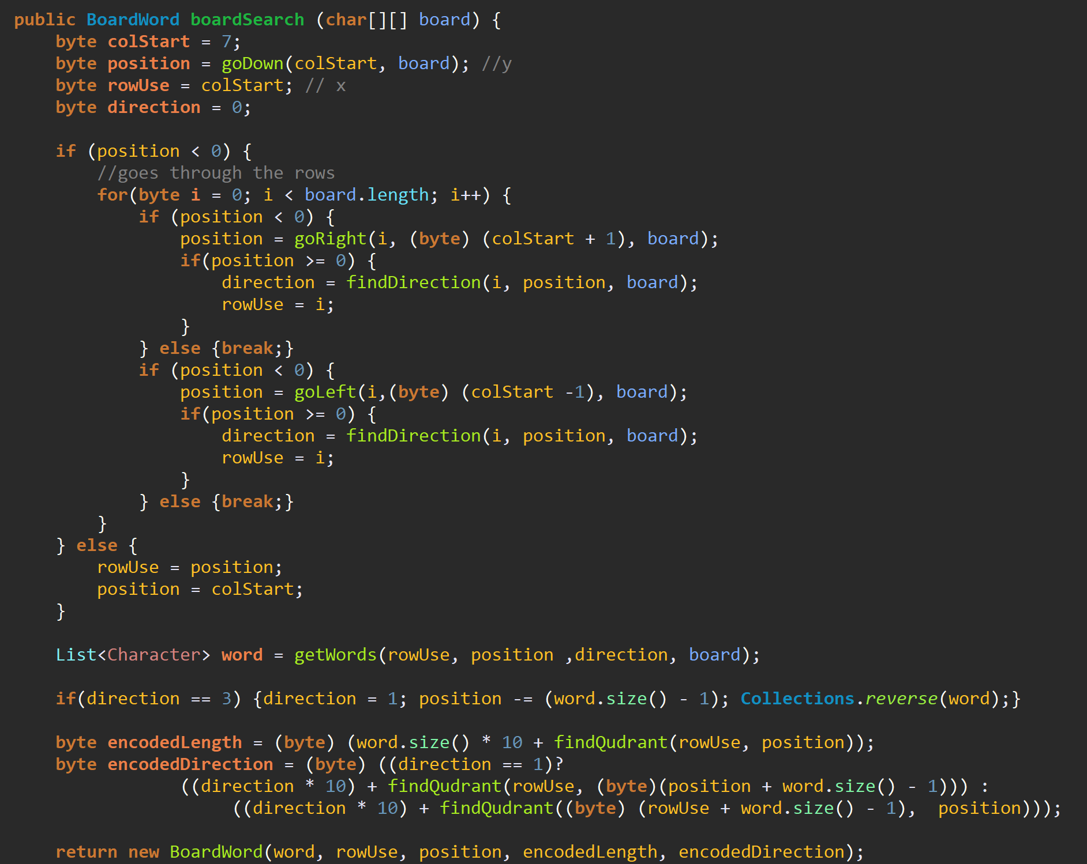
Traversing the Scrabble Board

Slide 12
Final Approach/ Submission

Slide 13
Changes in Algorithms and Supporting Data Structures

Slide 14
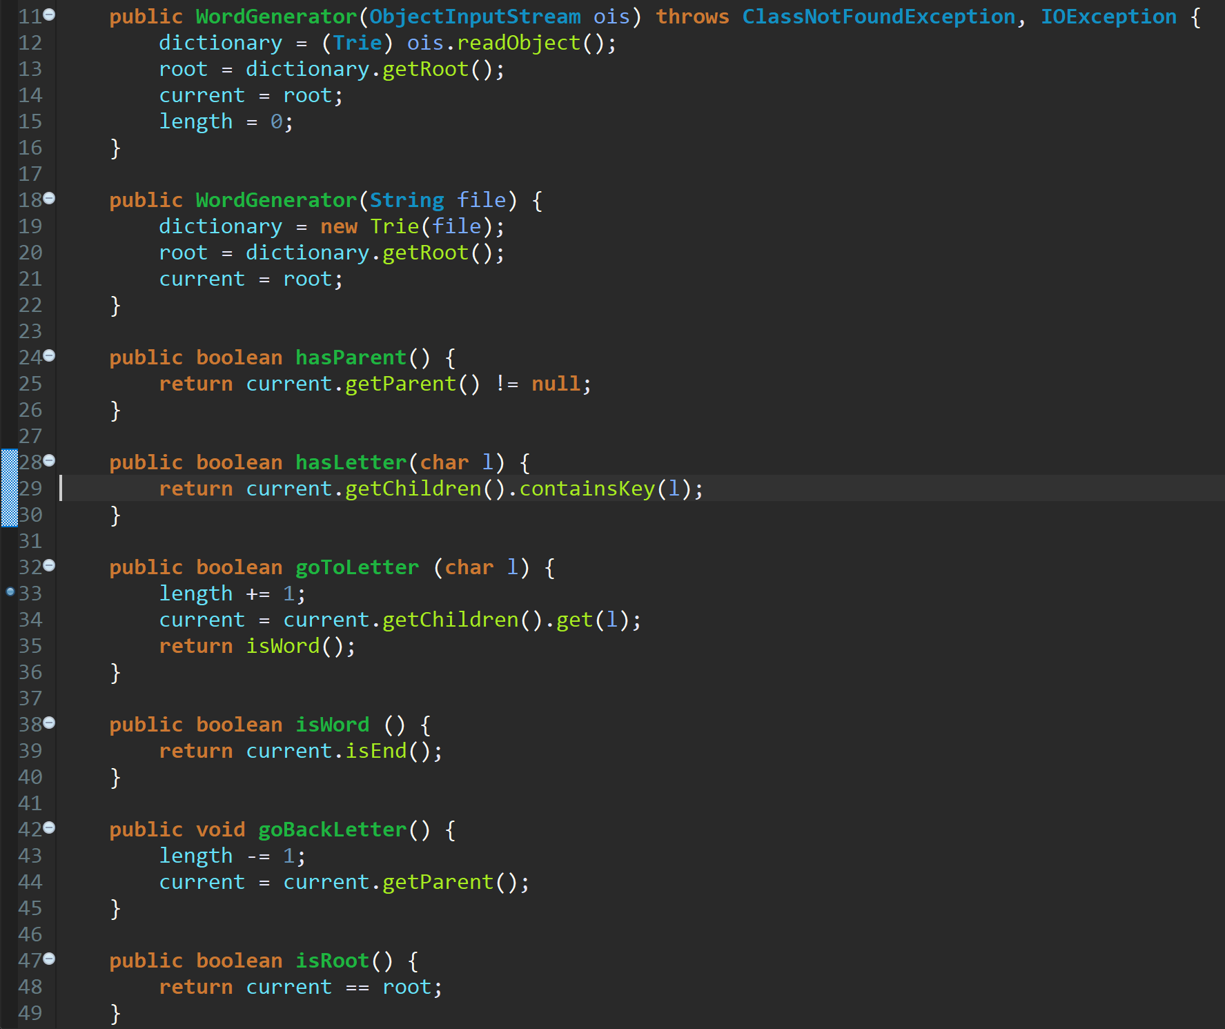
Word Generator

Slide 15
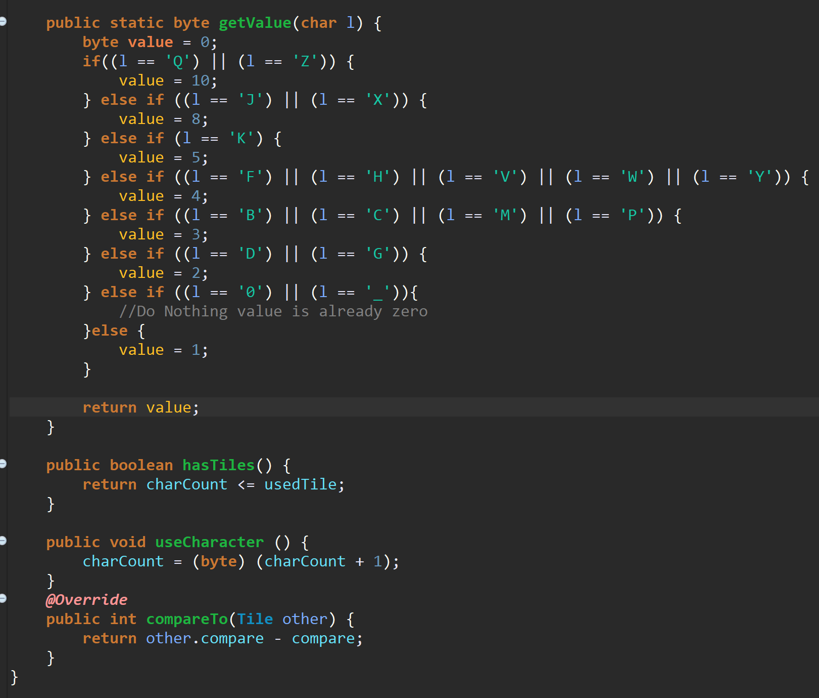
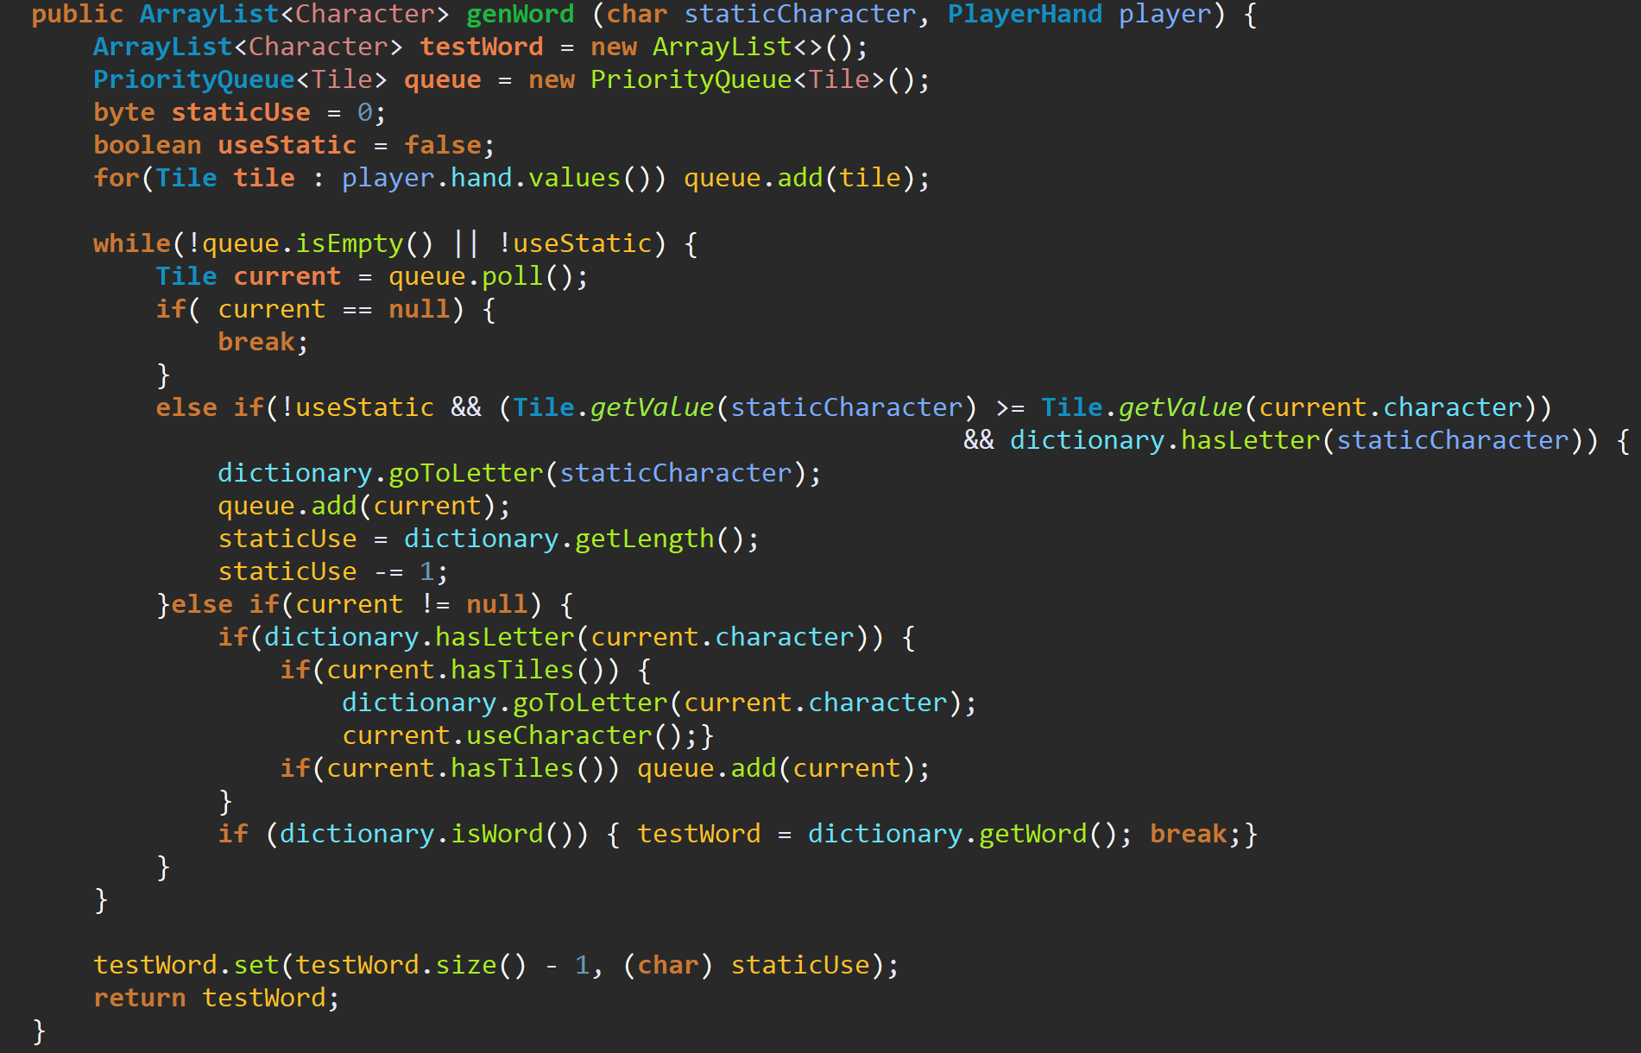
Tile

Slide 16
Analysis

Slide 17
Evaluation
Time:
Points:
Memory:
Performance:

Slide 18
Why More/Fewer Points

Slide 19
Why Faster/Slower

Slide 20
Why More/Less Memory

Slide 21
Possible Further Improvements

Slide 22
Thank You
Any Questions?

